Slide 1

SC1015 Mini Project
CO2 Emission by Vehicles
Group Members:
Chester Chiow Yong Xun
Eng Yi Xuan
Le Xuan Tung
Lab Group: FDAE
Team: 3
Car Emissions
PowerPoint Presentation Template

Slide 2
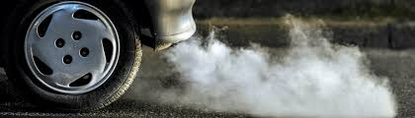

CO2 Emissions in Canada
In 2021, Canada's total greenhouse gas emissions were 670 megatonnes of carbon dioxide equivalent (Mt CO2 eq), a 1.8% increase from 2020.
22% of CO2 was from transportation
Motivation

Slide 3
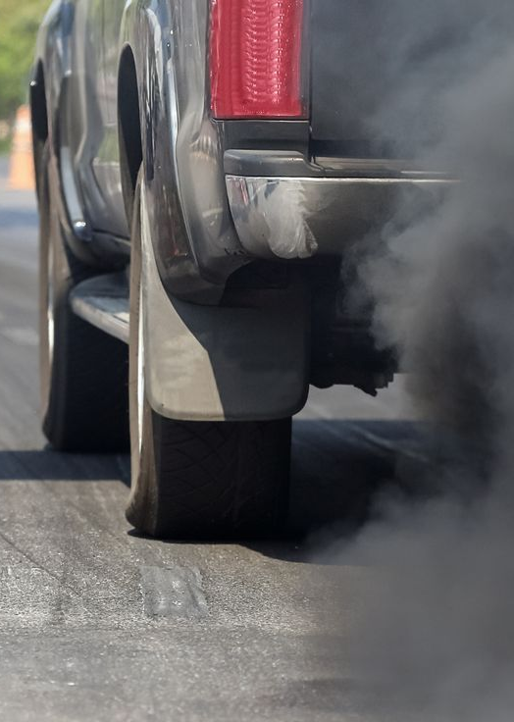
Real Life Problem
How can vehicle manufacturers design their products to minimize their overall environmental impact?
Motivation

Slide 4
How can we predict the amount of CO2 Emissions of a vehicle based on its specifications?
Problem Definition

Slide 5


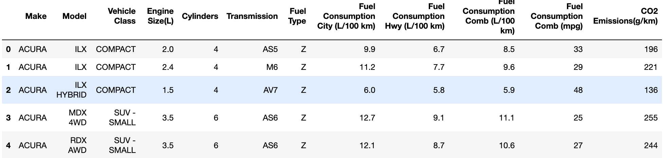
Size of Dataset:
7385 rows
12 columns
https://www.kaggle.com/datasets/debajyotipodder/co2-emission-by-vehicles/data
https://open.canada.ca/data/en/dataset/98f1a129-f628-4ce4-b24d-6f16bf24dd64#wb-auto-6
Sample Collection

Slide 6
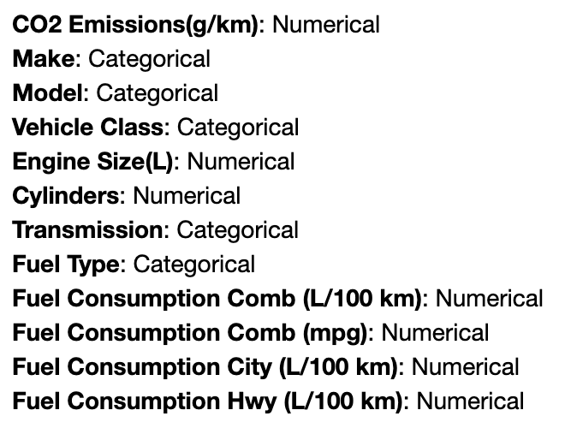
Variables
Response
Not specifications
Predictors
Accounted for in Fuel Consumption Comb (L/100 km)
55% City 45% Hwy
Data Preparation

Slide 7
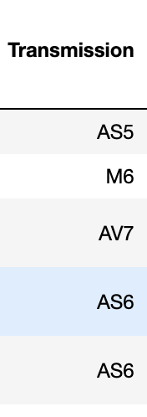
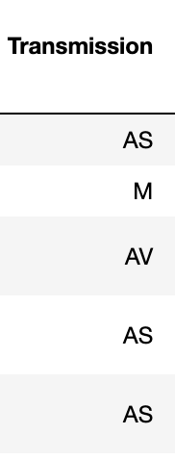
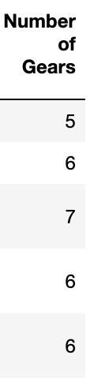
Data Preparation

Slide 8
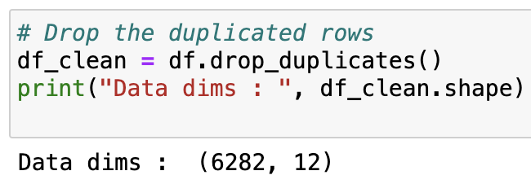
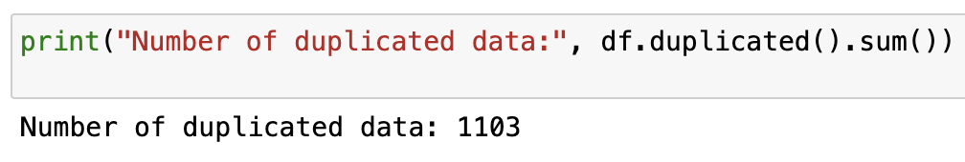
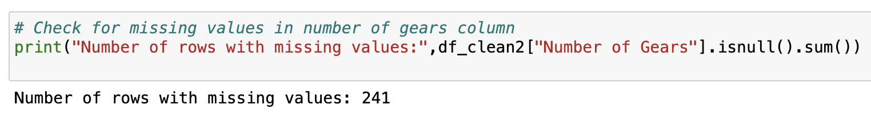
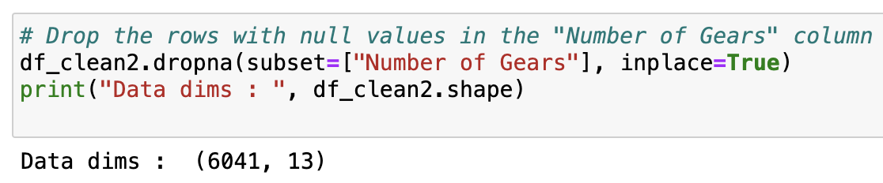
Check for Duplicated Data
Check for Missing Data
Data Preparation

Slide 9
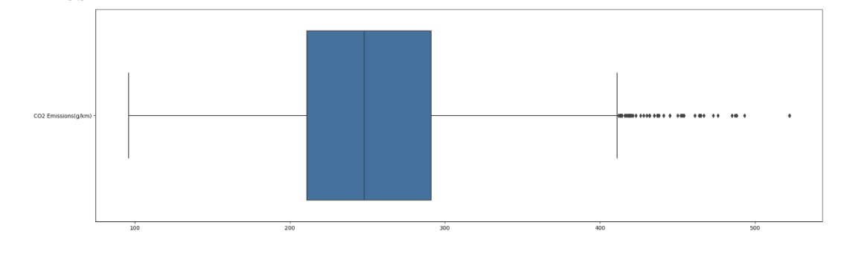
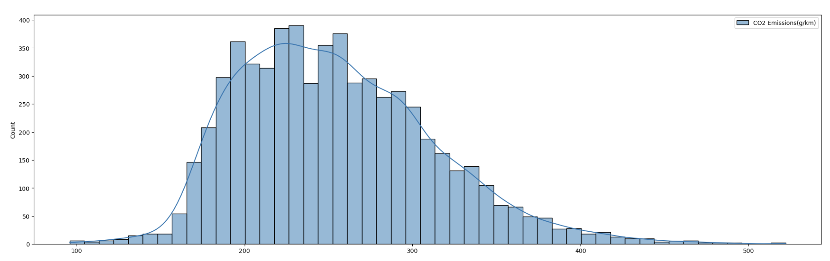
CO2 Emissions
Outliers
Positively Skewed
Exploratory Analysis

Slide 10
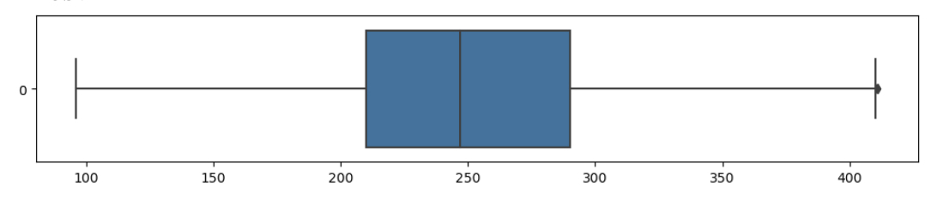
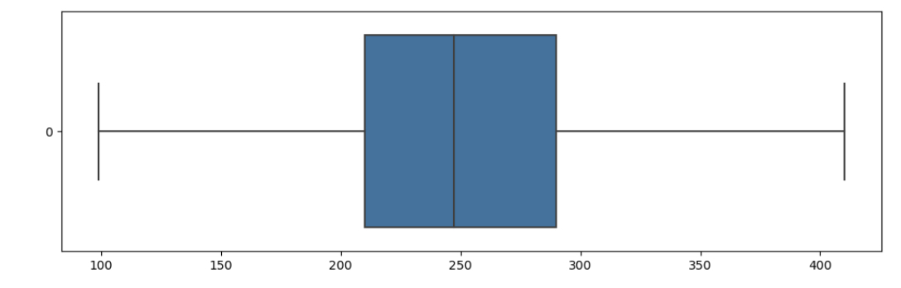
CO2 Emissions
Interquartile Range Method
Z-Score Method
Exploratory Analysis

Slide 11
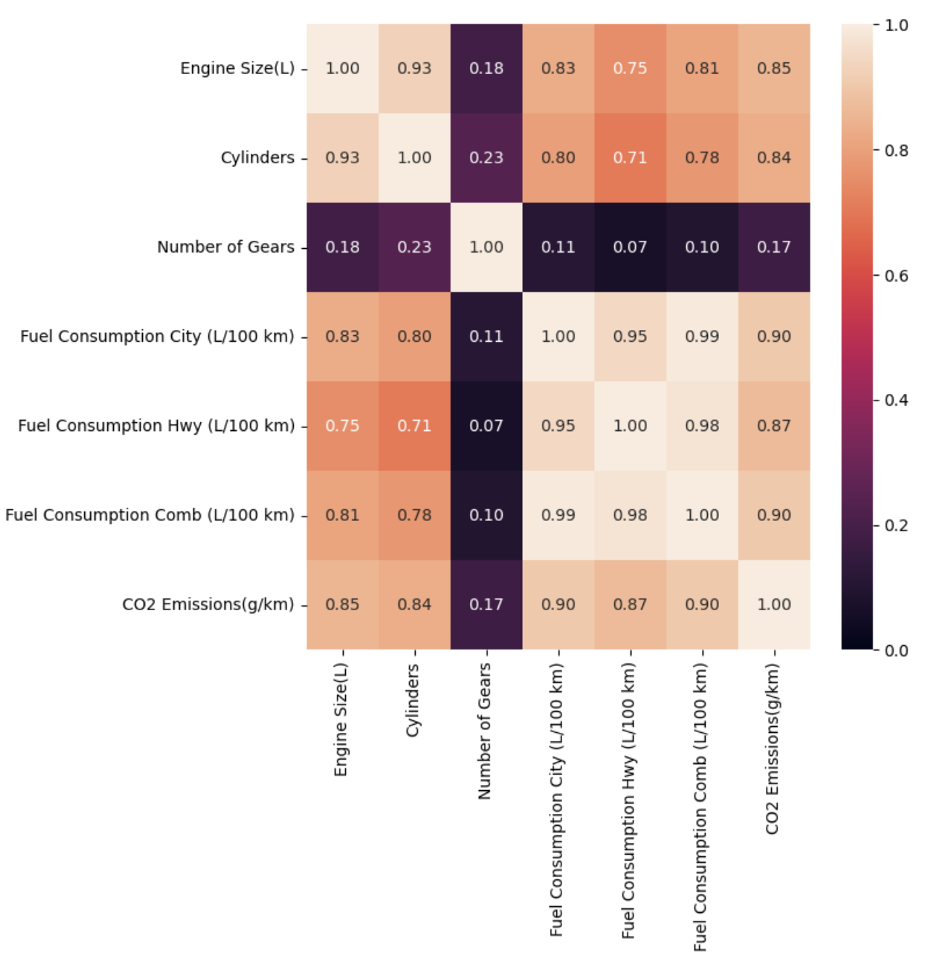
Numerical Variables against CO2 Emissions
Strong Positive Correlation between CO2 Emissions and the other Numerical Variables
Weak Positive Correlation between CO2 Emissions and Number of Gears
Strong Positive Correlation between Fuel Consumption Comb and both Cylinders and Engine Size
Exploratory Analysis

Slide 12
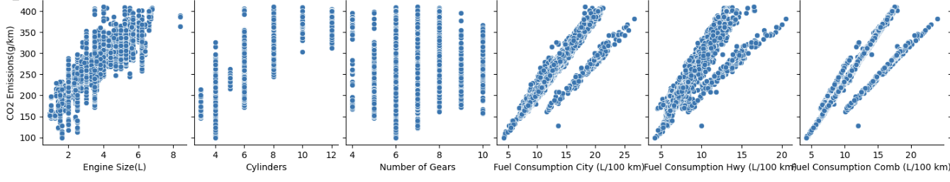
Numerical Variables against CO2 Emissions
Observations
Least Scattered
Increasing Trend
Distinct Lines
A Little Scattered
General Increasing Trend
Most Scattered
Some level of consistency in the relationship
May not be a Significant Factor
Maybe organised by different categorical variable.
Each categorical variable type may have different relationships between Fuel Consumption and CO2 Emissions
Insights
Exploratory Analysis

Slide 13
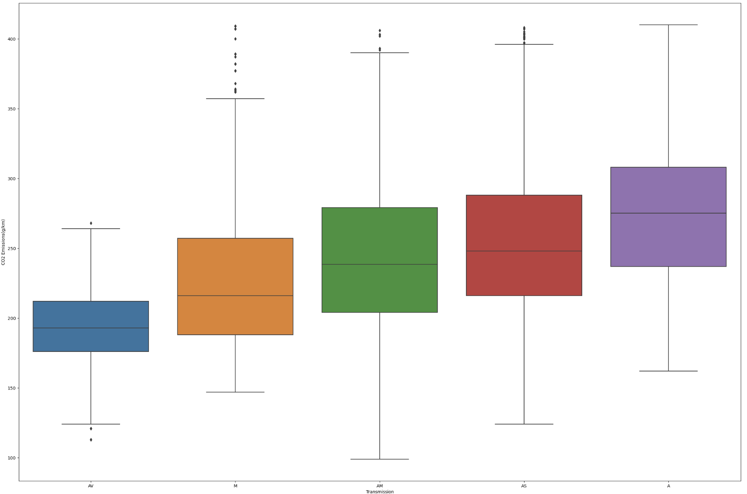
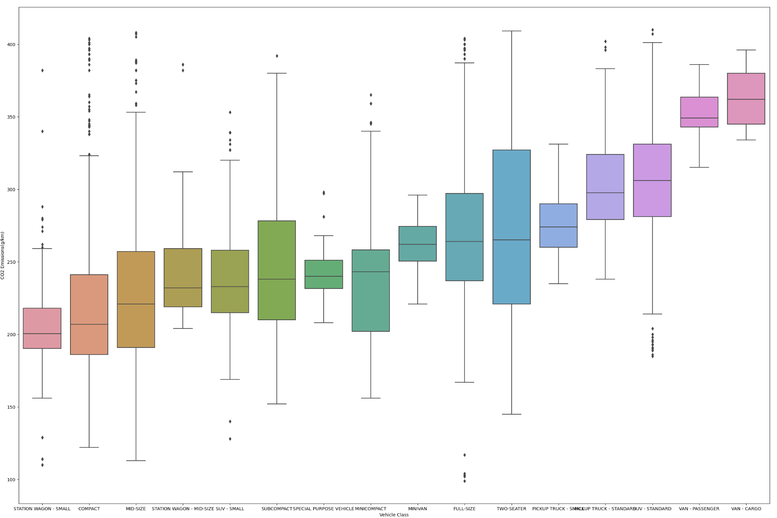
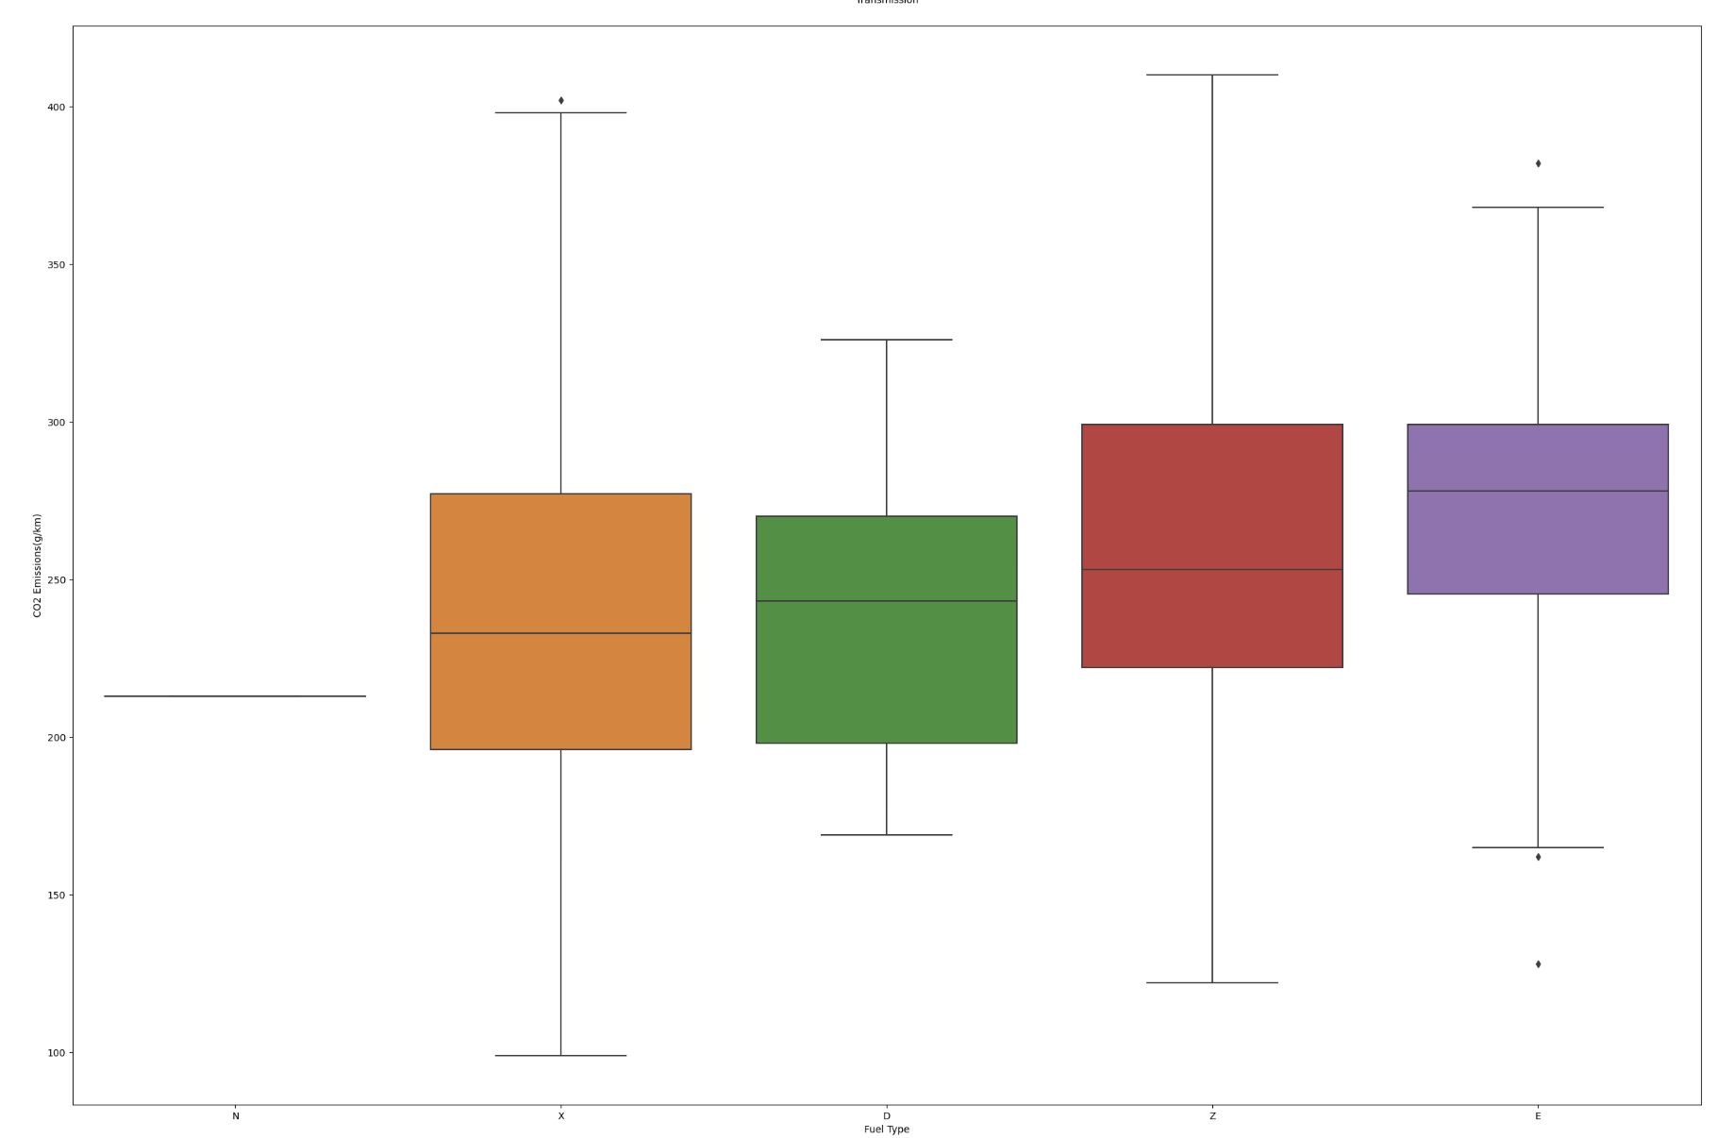
Categorical Variables against CO2 Emissions
Observations
CO2 emissions(g/km)
CO2 emissions(g/km)
Transmission
CO2 emissions(g/km)
Vehicle Class
Exploratory Analysis
Fuel Type

Slide 14
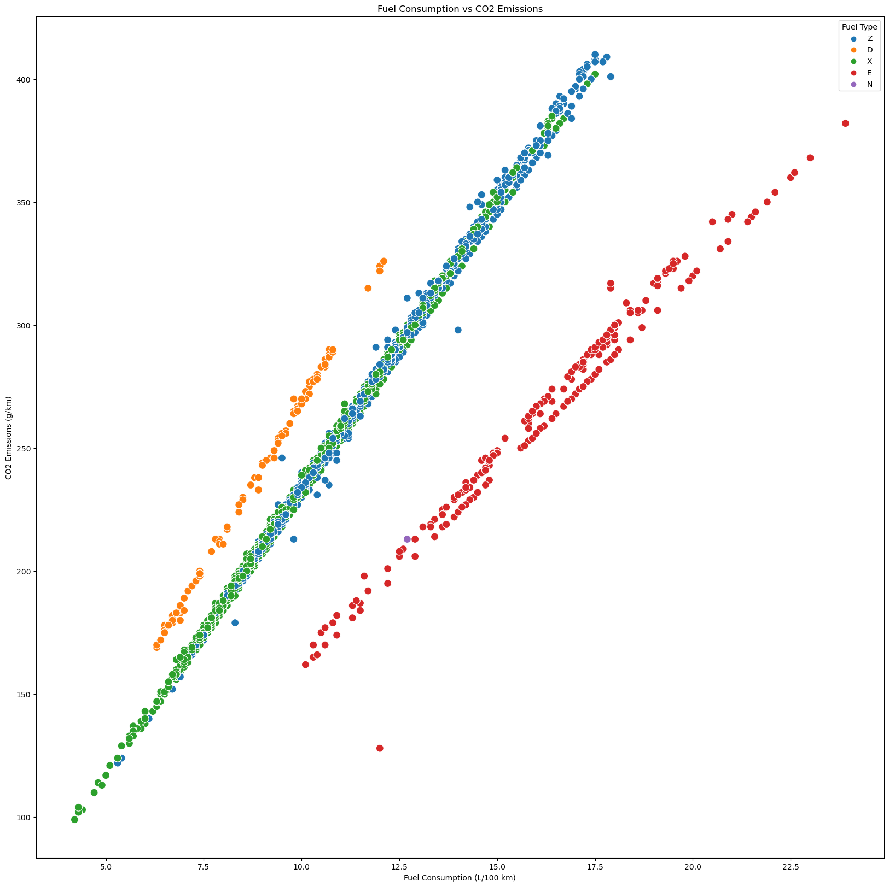
Fuel Type
Observations
Clear clusters
Orange plot points (Diesel) form the top line
Red plot points (Ethanol) form the bottom line
In general, for the same amount of Fuel Consumption, Diesel vehicles emit the most CO2 while Ethanol vehicles emit the least CO2.
CO2 emissions(g/km)
Insights
Fuel Type may be a significant factor influencing the relationship between CO2 Emissions and Fuel Consumption.
Different fuel types result in different levels of CO2 emissions for the same amount of fuel consumption.
Fuel Consumption(L/100km)
Exploratory Analysis

Slide 15
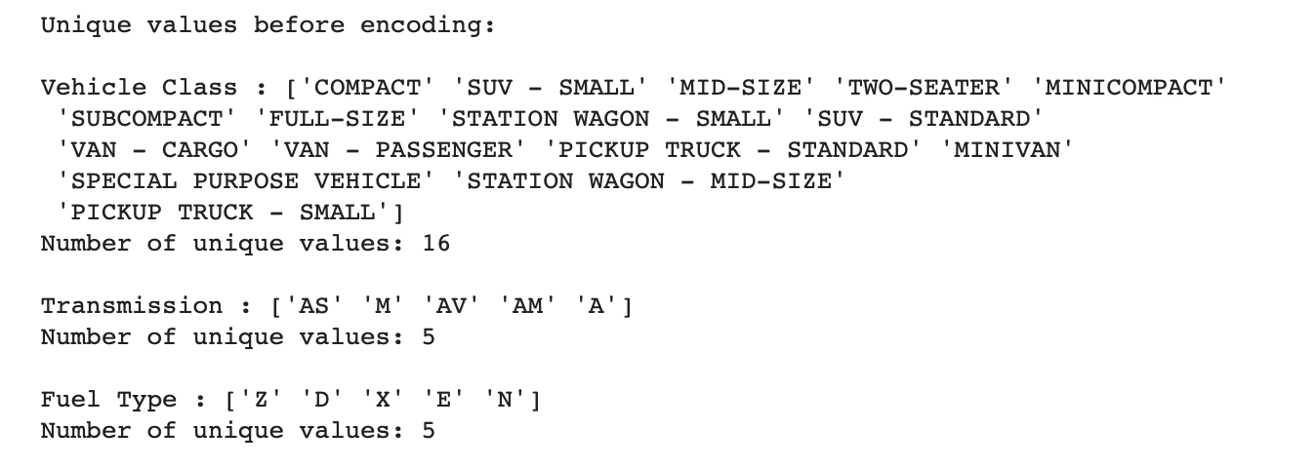
One Hot Encoding
Preserves the information contained within categorical variables
Transforms categorical data into numerical columns.

Slide 16
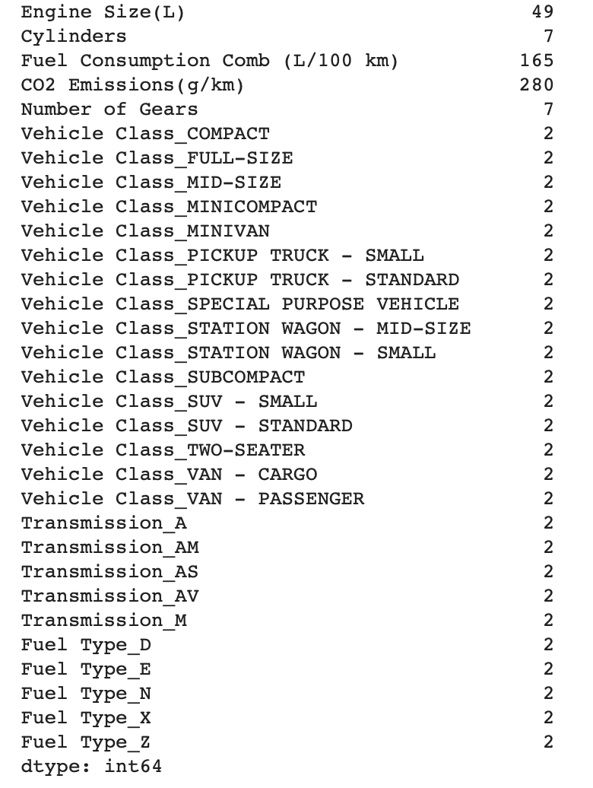
One Hot Encoding

Slide 17
Solution
Regression
Linear Regression
Random Forest for Regression
K-Nearest Neighbour Regression
Problem Type
Prediction: Numeric
Notes:
Next 3 minutes (approx.) of your presentation -- Core Analysis
If you used ML (regression, classification, or something else); mention mainly WHICH one(s).
You may now briefly CLARIFY why and how the ML problem(s) aim(s) to solve your objective.
How did you apply ML technique(s) to SOLVE your problem? Which model(s), how and why?
Did you only use tools and techniques learned in this course? What ELSE did you learn / try?

Slide 18

Why Regression?
Provide insights into the relationship between various vehicle specifications and environmental factors
Develop predictive models that can estimate CO2 emissions with reasonable accuracy
Regression analysis can be used to optimize vehicle designs for reduced environmental impact.

Slide 19
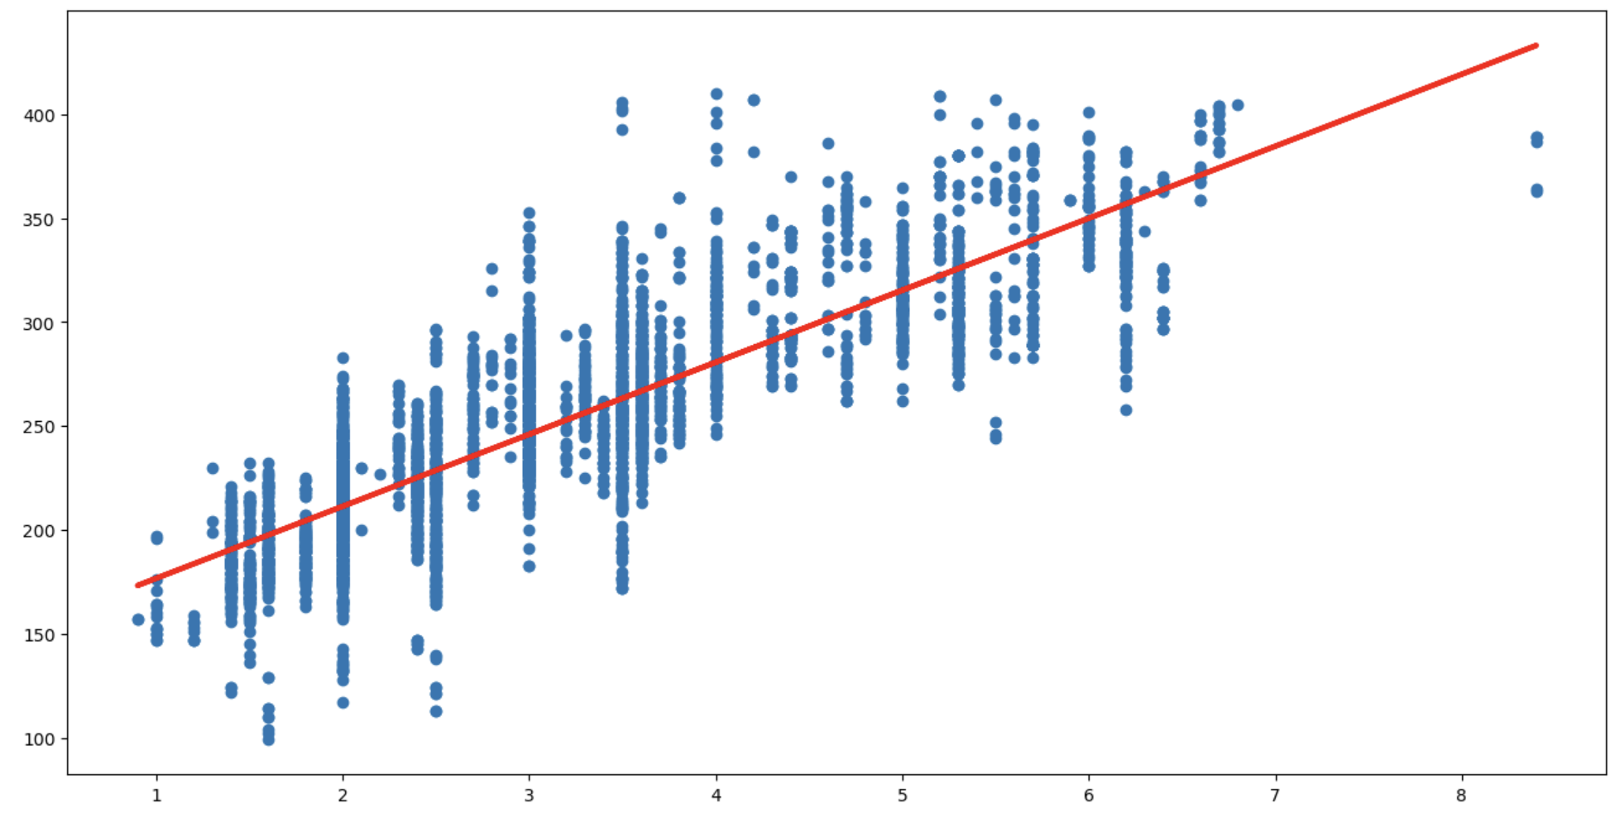
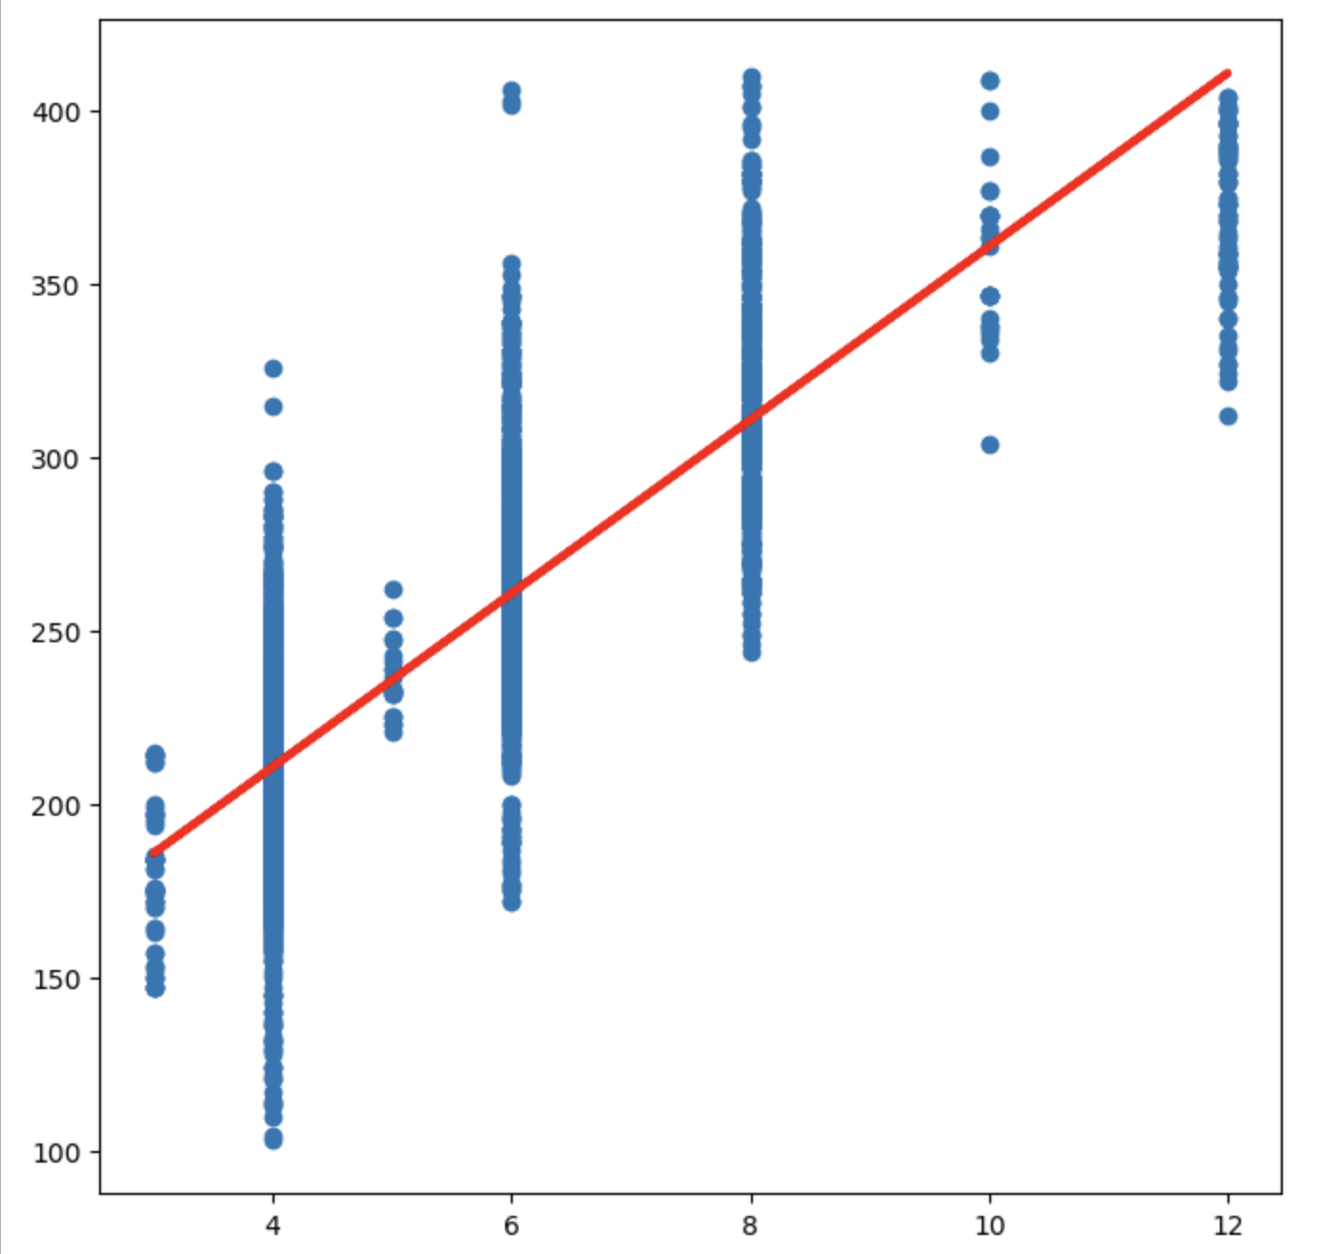

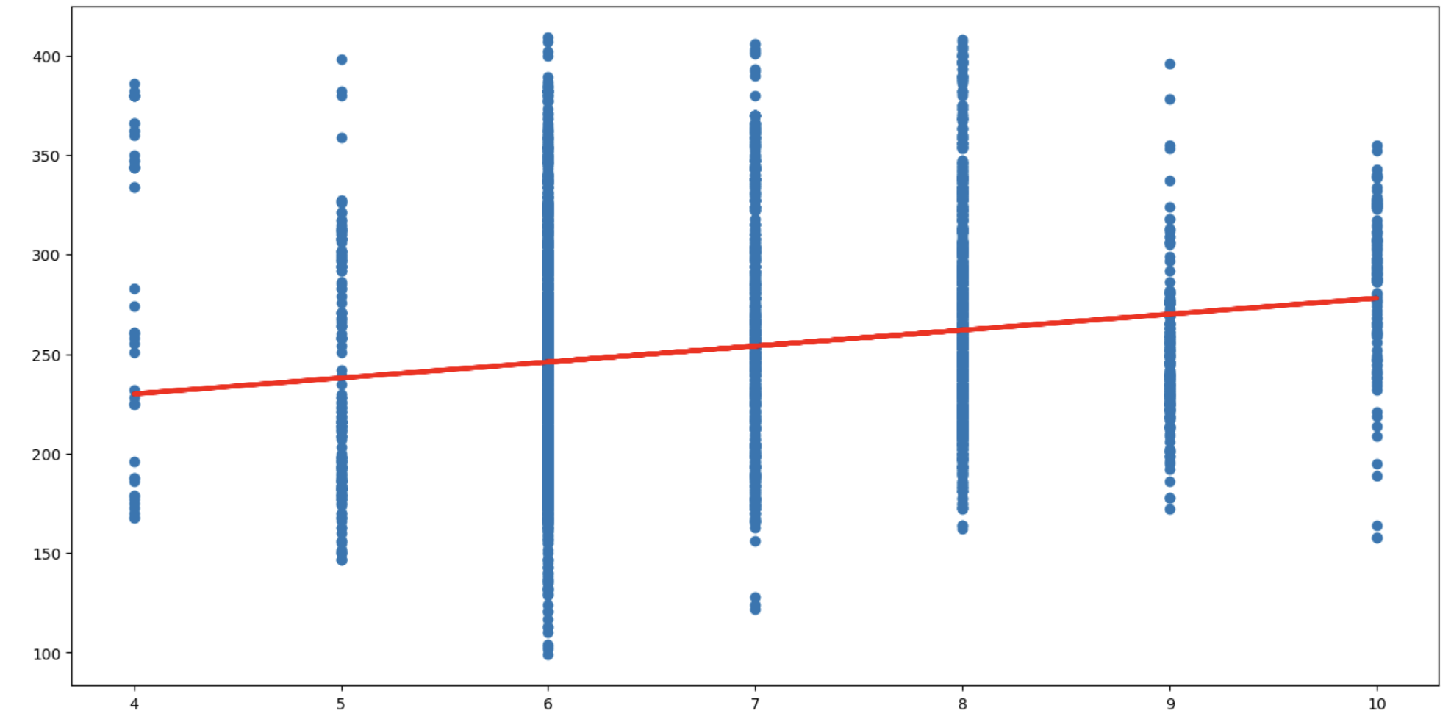
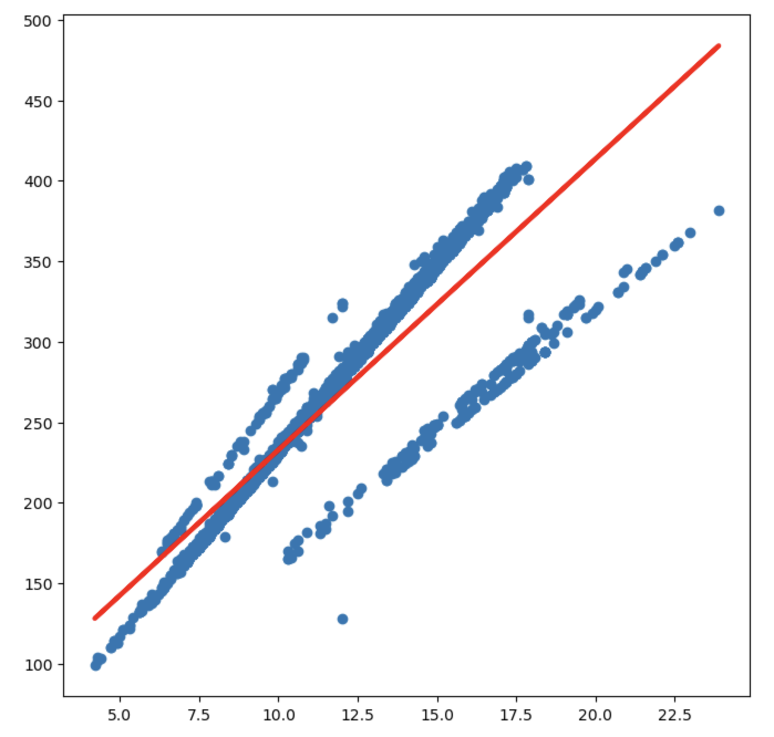
Machine Learning
Univariate Linear Regression
Engine Size vs CO2 Emission
Cylinders vs CO2 Emission
 | Train | Test
 | 0.72292 | 0.74554
MSE | 821.167 | 722.388
 | Train | Test
 | 0.69497 | 0.70781
MSE | 878.388 | 905.961
Number of Gears vs CO2 Emission
Fuel Consumption Comb vs CO2 Emission
 | Train | Test
 | 0.81971 | 0.80026
MSE | 540.763 | 548.822
 | Train | Test
 | 0.03173 | 0.02224
MSE | 2868.262 | 2786.467
 | Train | Test
 | 0.81971 | 0.80026
MSE | 540.763 | 548.822

Slide 20
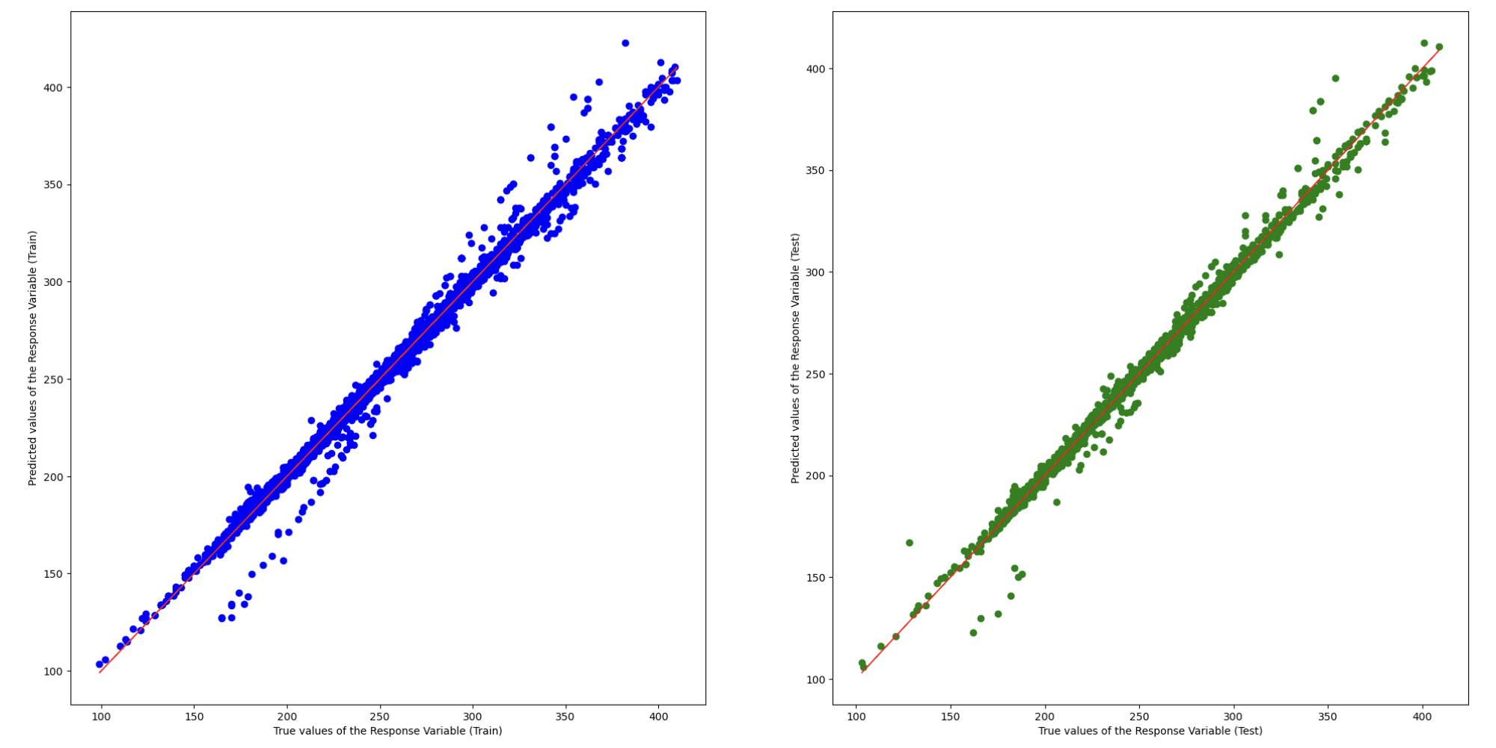
Machine Learning
Multivariate Linear Regression
Adjusted :
A modified version of
that adjusts for the number of predictors in the model.
 | Train | Test
Adjusted | 0.99165 | 0.99037
 | 0.99170 | 0.99056
MSE | 24.394 | 27.593
Train Data
Test Data

Slide 21
Machine Learning
Random Forest for Regression
Bootstrapping
Training Data
Random Feature Selection
Tree 1
Tree 400
(...)
(...)
Prediction 400
Prediction 1
Average All Predictions
Random Forest Predictions

Slide 22
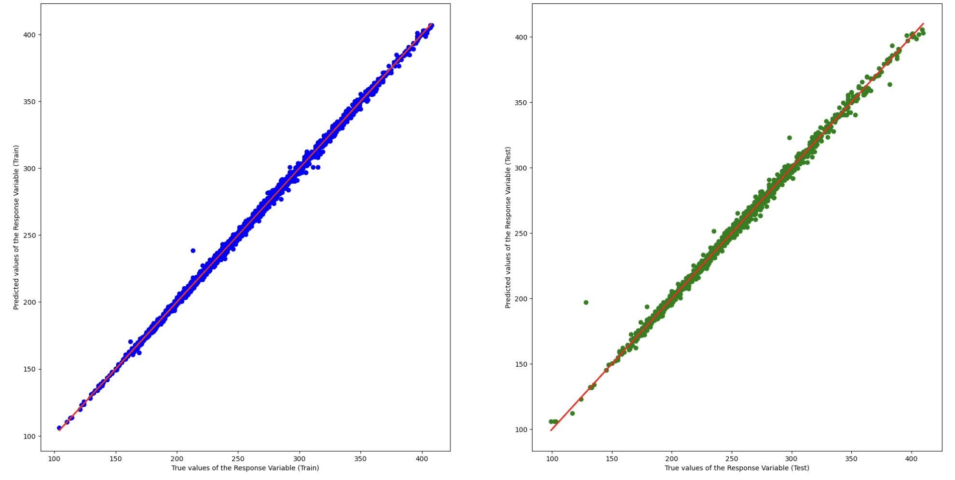
Machine Learning
Random Forest for Regression
 | Train | Test
Adjusted | 0.99903 | 0.99551
 | 0.99904 | 0.99560
MSE | 2.843 | 12.352
Train Data
Test Data

Slide 23
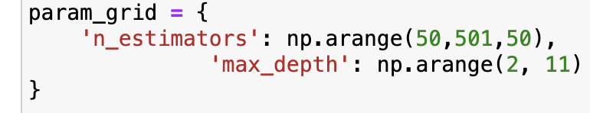
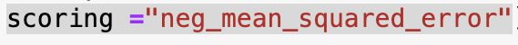
Machine Learning
Random Forest for Regression
Cross-Validation using GridSearch
Hyperparameters:
n_estimators : number of trees 50, 100, …, 500
max_depth : depth of trees 2, 3, 4, 5, …, 10
Scoring Function : Negative MSE
Results after Cross-Validation
 | Train | Test
Adjusted | 0.99843 | 0.99724
 | 0.99844 | 0.99729
MSE | 4.508 | 8.205
Hyperparameters:
n_estimators : 10
max_depth : 400

Slide 24
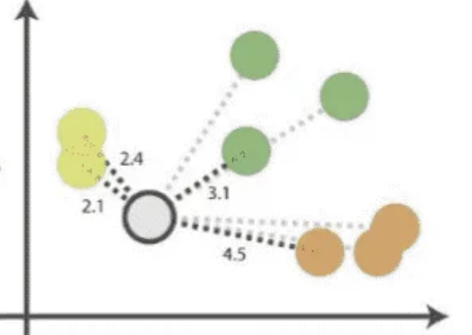
Machine Learning
K-Nearest Neighbour (KNN) Regression
Calculate distances between new data point and training points
Select the closest K data points
Take average of these data points
Final Prediction
_______
=
1
2
3
3

Slide 25
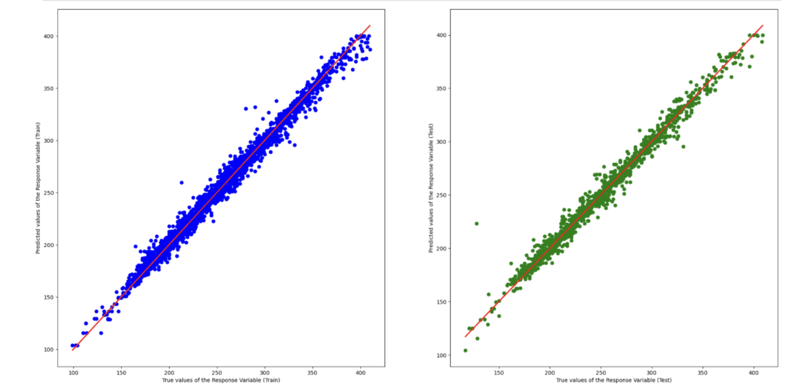
Machine Learning
K-Nearest Neighbour (KNN) Regression
 | Train | Test
Adjusted | 0.99906 | 0.98533
 | 0.99069 | 0.98533
MSE | 27.333 | 43.054
Train Data
Test Data

Slide 26
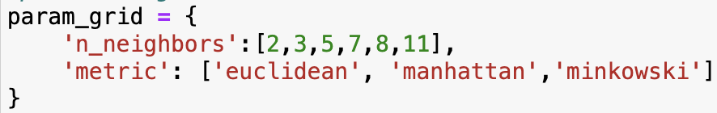
Machine Learning
K-Nearest Neighbour (KNN) Regression
Cross-Validation using GridSearch
Hyperparameters:
distance metrics : euclidean/manhattan/minkowski
n_neighbours(k) : 1,2,3,4..
Scoring Function : Negative MSE
Results after Cross-Validation
 | Train | Test
Adjusted | 0.99689 | 0.98875
 | 0.99692 | 0.98897
MSE | 9.009 | 32.695
Hyperparameters:
distance metrics : euclidean
n_neighbours(k) : 2

Slide 27
Machine Learning
Outcome
Random Forest for Regression
Linear Regression
 | Train | Test
Adjusted | 0.99165 | 0.99037
 | 0.99170 | 0.99056
MSE | 24.394 | 27.593
 | Train | Test
Adjusted | 0.99844 | 0.99724
 | 0.99845 | 0.99730
MSE | 4.508 | 8.206
K-Nearest Neighbors Regression
 | Train | Test
Adjusted | 0.99689 | 0.98875
 | 0.99692 | 0.98897
MSE | 9.009 | 32.695
<

Slide 28
Problem Definition:
How can we predict the amount of CO2 Emissions of a vehicle based on its specifications?
Data Driven Insights
Fuel Consumption Comb is the most significant factor
Cylinders and Engine Size play important roles in determining Fuel Consumption Comb.
For the same amount of Fuel Consumption Comb, Diesel emits most CO2 and Ethanol emits the least CO2.
Conclusion

Slide 29
Problem Definition:
How can we predict the amount of CO2 Emissions of a vehicle based on its specifications?
Data Driven Insights
Random Forest Regression Model is most effective in predict CO2 Emissions
Compared to Linear Regression, Random Forest Regression can capture nonlinear relationships
Compared to KNN Regression, Random Forest Regression is less prone to overfitting because it averages predictions from multiple trees, which helps reduce variance
Conclusion

Slide 30
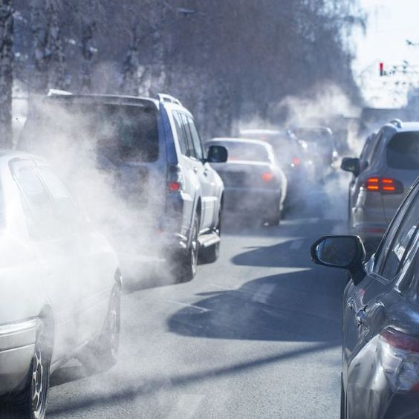
Recommendations
Prioritise efforts to reduce fuel consumption
Focus on strategies to lower the number of cylinders and engine size in vehicles.
Consider choice of fuel
Balance environmental friendliness and performance of vehicle
Conclusion

Slide 31
References
https://www.kaggle.com/datasets/debajyotipodder/co2-emission-by-vehicles/data
https://www.canada.ca/en/environment-climate-change/services/environmental-indicators/greenhouse-gas-emissions.html
https://www.way.com/blog/what-are-cylinders-in-a-car-all-you-need-to-know/
https://www.analyticsvidhya.com/blog/2022/08/dealing-with-outliers-using-the-z-score-method/
https://saturncloud.io/blog/linear-regression-with-sklearn-using-categorical-variables/#:~:text=To%20use%20categorical%20variables%20in,label%20encoding%2C%20and%20binary%20encoding.
https://towardsdatascience.com/random-forest-regression-5f605132d19d
https://towardsdatascience.com/a-quick-and-dirty-guide-to-random-forest-regression-52ca0af157f8
https://www.analyticsvidhya.com/blog/2018/08/k-nearest-neighbor-introduction-regression-python/

Slide 32
Thank You

